Slide 1
The Data-Driven Car Buying Assistant: An Analysis of the Indian Used Car Market

Slide 2
The used car market in India is a vast, complex, and often uncertain environment for buyers and sellers. In short it is messy. A customer standing in a dealership and a dealer trying to price their inventory face the same fundamental questions:
What is this car really worth?
What factors truly drive its price?
And how can I be sure I'm making a good financial decision?

Slide 3
This report documents our "Data-Driven Car Buying Assistant," a project built using Python, Pandas, and NumPy to analyze a real-world dataset of over 2,000 used car listings from CarDekho.

Slide 4
Our analysis confirms that a car's price is not arbitrary. We've quantitatively proven:
Wear-and-Tear is Real: age and kms_driven are the strongest negative factors, giving buyers a clear negotiating tool.
Not All Brands Are Equal: We identified brands like Toyota and Honda that hold their value exceptionally well, while others (like Chevrolet) show significant depreciation, offering "resale loss" insights for customers.
Features Have a Price Tag: We found that Automatic cars, Diesel engines, and First Owner vehicles command a significant and quantifiable price premium over their counterparts.

Slide 5
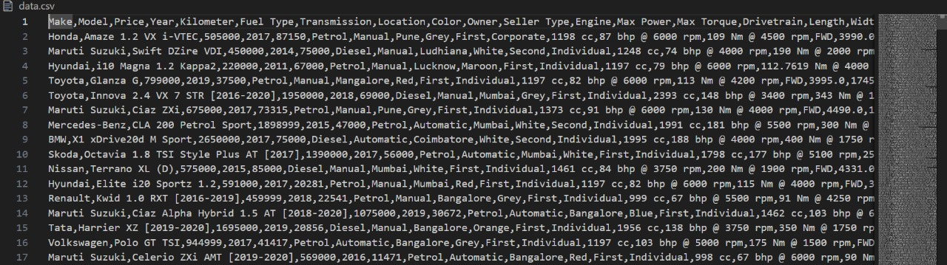
We took a dataset from Kaggle where we took the details of more than 2k cars. It is the data.csv file where we accessed the information for python file.

Slide 6
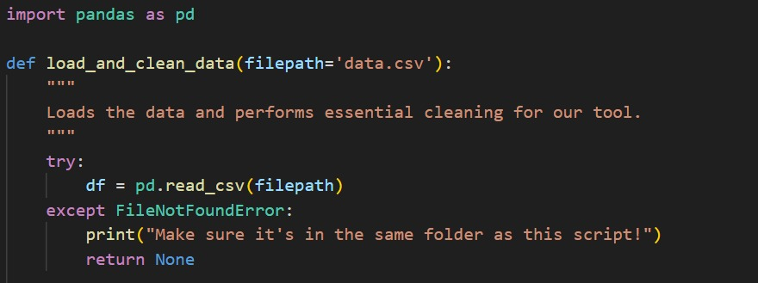
First ,we imported the Pandas module to use the csv file.
Then we defined a function to load and clean the data.
Standardize Text: This is its main job. It loops through all text columns (Make, Fuel Type, etc.) and converts them to Title Case (e.g., petrol becomes Petrol, HYUNDAI becomes Hyundai). This is crucial for matching user input.
It finds the missing values, drop the rows which has missing columns, converts YEAR column to a number and returns completely cleaned data.

Slide 7
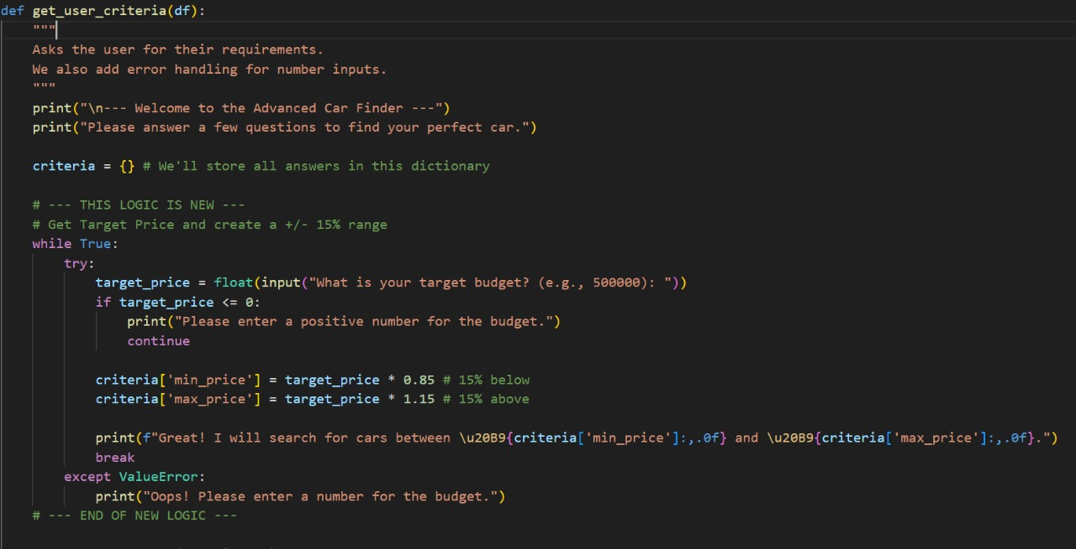
Here, this function is used for the user input where we would get to know his/her desired qualifications for the car he/she wants to buy.
“Criteria” dictionary is used to store all the answers
In fact, we even took a 15% buffer price range so as customer would get the idea of the cars near to his/her budget too.
Similarly, we took Oldest Year, fuel type, maximum kilometres driven, transmission type, preferred make even the owner type too to help the user find the desired car.

Slide 8
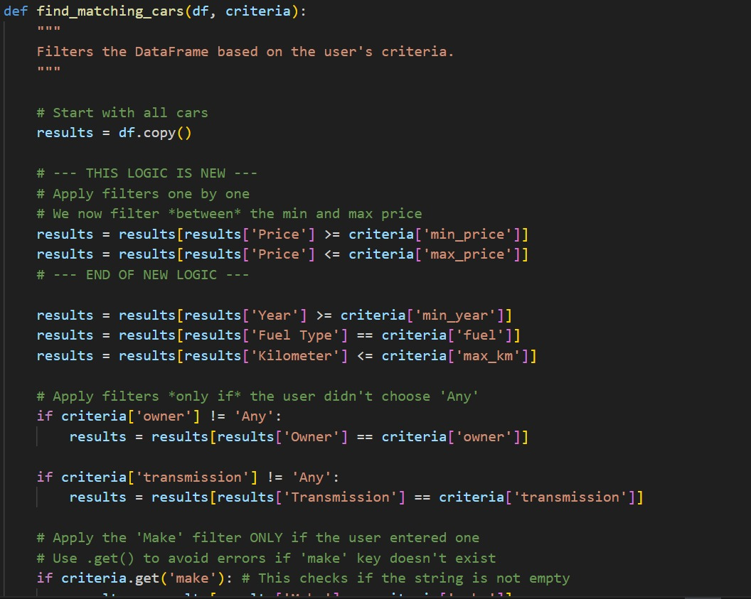
It is used to print the results neatly, define which columns to show.
It renames column for multi-line display. It fixes the formatting and prints the results without the index number.

Slide 9
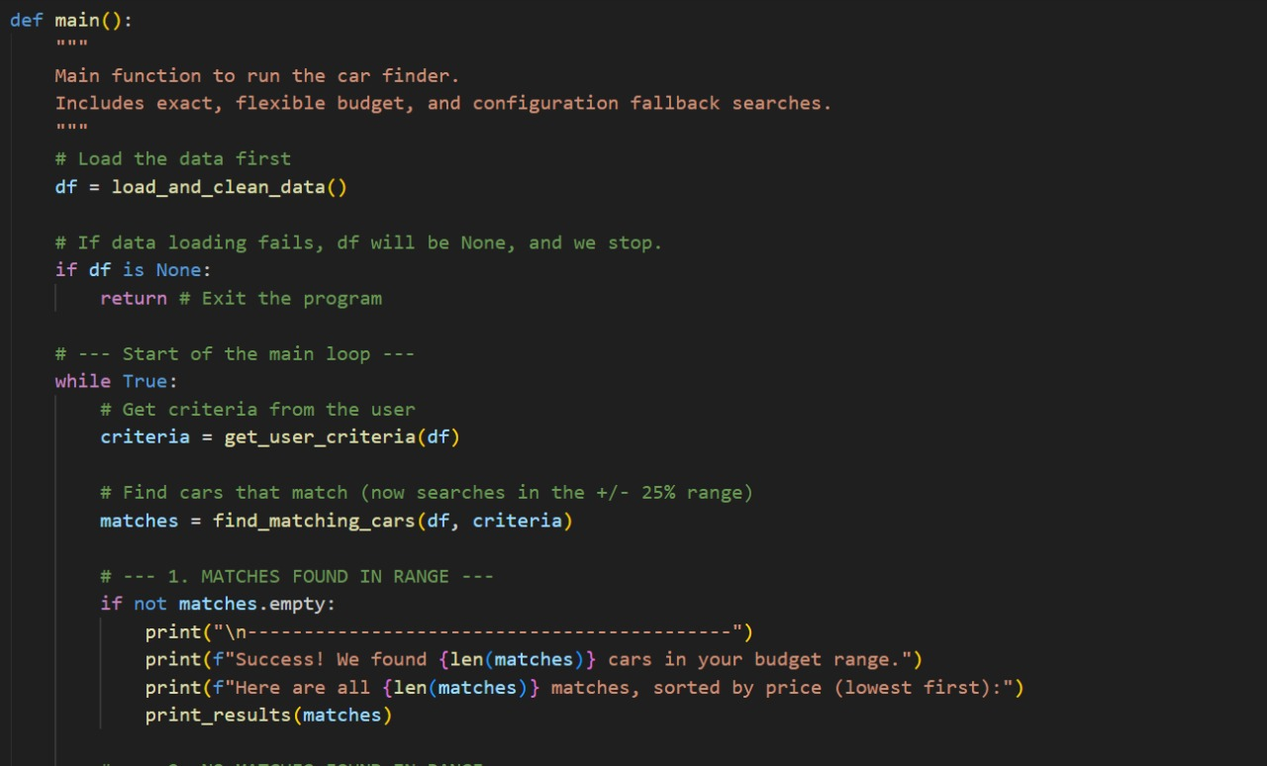
It calls all the user defined functions which we defined above.
Start Loop: It starts a while True loop to let the user search repeatedly.
If no cars are found, it checks if the user specified a specific ‘make’ (e.g., "Honda").
The loop starts over, asking for new criteria.

Slide 10

It is the standard python line to run main() function.

Slide 11
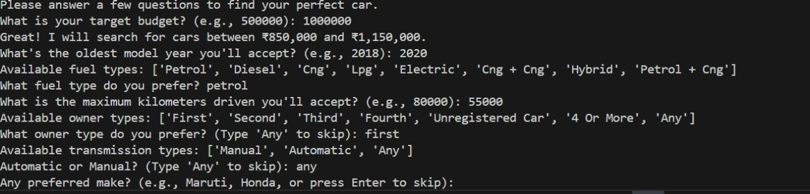
This is the random output.

Slide 12
THANK YOU!

